Slide 1

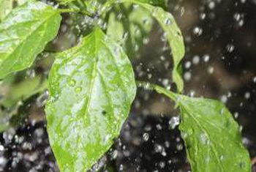
AUTOMATIC IRRIGATION SYSTEM-A STEP TOWARDS HEALTHY FUTURE

Slide 2

Members Of The Team
Tanya Mittal ( Group Leader)
Kinshuk Aggarwal
Ketan Khandelwal
Uttkarsh Pandey
Lavish Chandani
Shagun Saroha
Kriti Rai
Rashmita Piplani
Anmol Karnwal
Swarnika

Slide 3

INDEX
Introduction
Working
Application
Merits
Conclusions

Slide 4
INTRODUCTION
In the world of advance electronics life of human beings should be simpler hence to make life more simpler and convenient we have made “AUTOMATIC PLANT IRRIGTION SYSTEM”.
A model of controlling irrigation facilities to help millions of people living on earth as well as for coming future. With the advent of technology we are facing a problem of lack of plants and trees on earth. So our model will help for this new era of plantation.
This model uses sensors technology with Arduino circuit to make a smart switching device.

Slide 5
Working
Our project consist of three stages ‘Sensor Circuit’, ‘Arduino Circuit’ & ‘Motor Driver Circuit’.
Sensor Circuit senses the condition of the Soil and compare the voltage with the reference voltage.
If the condition of the soil is less than the reference voltage i.e. Dry then Arduino circuit sends the high Signal Logic, this will turn on the motor driver circuit with the help of Arduino and make motor to pump to make water to reach to the field.

Slide 6
When the soil becomes wet that is greater then reference voltage the Program sends logic ‘0’ signal to the Arduino which will turn off the motor driver circuit and stop pumping water to the field.
The condition of motor and soil are displayed in the LED screen.
In this way the process is repeated, whenever there is a need of water to the field.

Slide 7
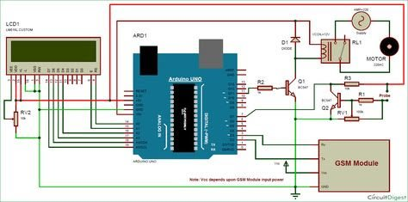
CIRCUIT DIAGRAM

Slide 8
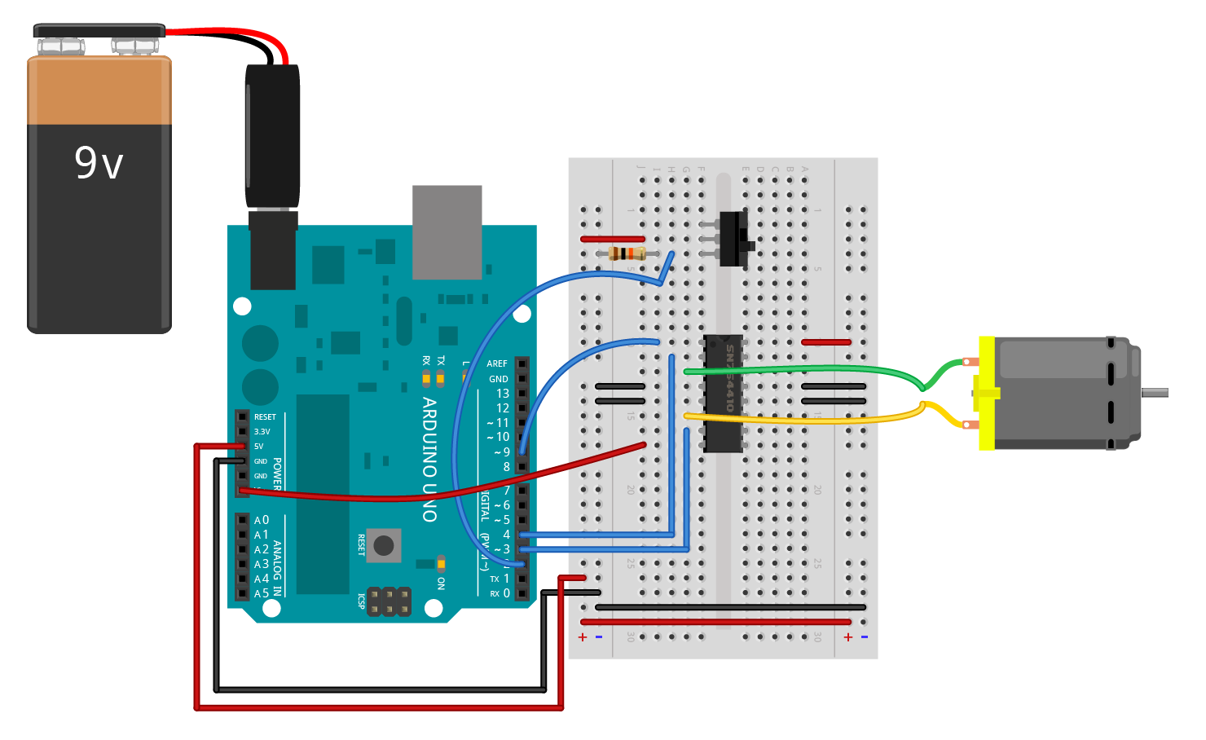
APPLICATIONS
Irrigation in fields.
Irrigation in gardens and parks.
Very efficient for farmers for farming Paddy, Rice fields.
Good way to carry Pisciculture.
Helps in increasing Rate of Plantation.

Slide 9
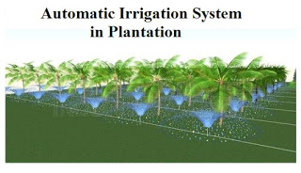
MERITS
Highly sensitive, low cost and reliable circuit.
Work according to the soil condition.
Complete elimination of man power.
Can handle heavy loads up to 4A.
System can be switched into manual mode whenever required.

Slide 10
CONCLUSION
In present days specially farmers are facing major problems in watering their Agricultural fields, its because they have no proper idea about when power is available so that they can pump water. Even after then they need to wait until the field is properly watered which make them to stop doing other activity . Here is an idea which help not only farmers but even gardener also. Which senses the soil and switches the pump automatically when the power is On.

